Slide 1
LAB#02
OBJECT: Designing Class Diagram & Sequence Diagram.

Slide 2
CLASS DIAGRAM
It represents the static view of an application.
Class diagram is not only used for visualizing, describing and documenting different aspects of a system but also for constructing executable code of the software application.
The class diagrams can be mapped directly with object oriented languages. (used at the time of construction)

Slide 3
A class diagram is an illustration of the relationships and source code dependencies among classes in the Unified Modeling Language (UML).
In this context, a class defines the methods and variables in an object, which is a specific entity in a program or the unit of code representing that entity.

Slide 4
PURPOSE
Analysis and design of the static view of an application.
Show the collaboration among the elements of the static view.
Describe the functionalities performed by the system.
Construction of software applications using object oriented languages.
Forward and reverse engineering.

Slide 5
NOTATION
Classes are portrayed as boxes, each box having three rectangles inside.
The top rectangle contains the name of the class; the middle rectangle contains the attributes of the class; the lower rectangle contains the methods, also called operations, of the class.
Lines, which may have arrows at one or both ends, connect the boxes. These lines define the relationships, also called associations, between the classes.

Slide 6
GUIDELINES
The name of the class diagram should be meaningful to describe the aspect of the system.
Relationships should be identified
Responsibility (attributes and methods) of each class should be clearly identified.
Use notes when ever required to describe some aspect of the diagram. Because at the end of the drawing it should be understandable to the developer/coder.

Slide 7
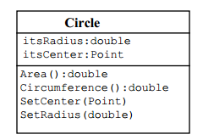

Slide 8
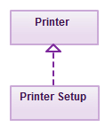
RELATIONSHIPS IN CLASS DIAGRAMS
Association: is a broad term that encompasses just about any logical connection or relationship between classes.
Inheritance/Generalization
Realization: denotes the implementation of the functionality defined in one class by another class

Slide 9
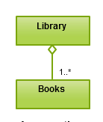
RELATIONSHIPS IN CLASS DIAGRAMS
Aggregation: refers to the formation of a particular class as a result of one class being aggregated or built as a collection. For example, the class “library” is made up of one or more books, among other materials. In aggregation, the contained classes are not strongly dependent on the life cycle of the container. In the same example, books will remain so even when the library is dissolved.

Slide 10
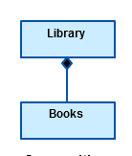
Composition: Composition is very similar to the aggregation relationship, with the only difference being its key purpose of emphasizing the dependence of the contained class to the life cycle of the container class

Slide 11
Multiplicity
is the active logical association when the cardinality of a class in relation to another is being depicted. For example, one fleet may include multiple airplanes, while one commercial airplane may contain zero to many passengers. The notation 0..*

Slide 12
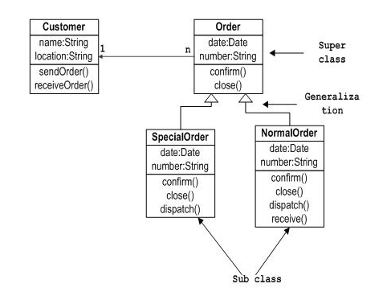
SAMPLE CLASS DIAGRAM

Slide 13
SEQUENCE DIAGRAM
The Sequence Diagram models the collaboration of objects based on a time sequence.
It depicts the objects and classes involved in the scenario and the sequence of messages exchanged between the objects needed to carry out the functionality of the scenario.
Sequence diagrams are typically associated with use case realizations in the Logical View of the system under development.

Slide 14
NOTATION
A sequence diagram shows, as parallel vertical lines (lifelines), different processes or objects that live simultaneously, and, as horizontal arrows, the messages exchanged between them, in the order in which they occur. This allows the specification of simple runtime scenarios in a graphical manner.

Slide 15
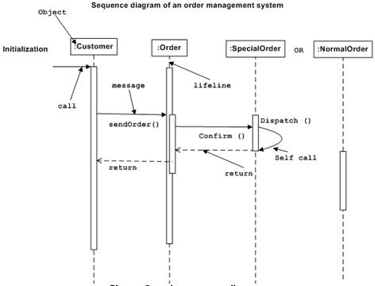

Slide 16
PURPOSE
To capture dynamic behaviour of a system.
To describe the message flow in the system.
To describe structural organization of the objects.
To describe interaction among objects.

Slide 17
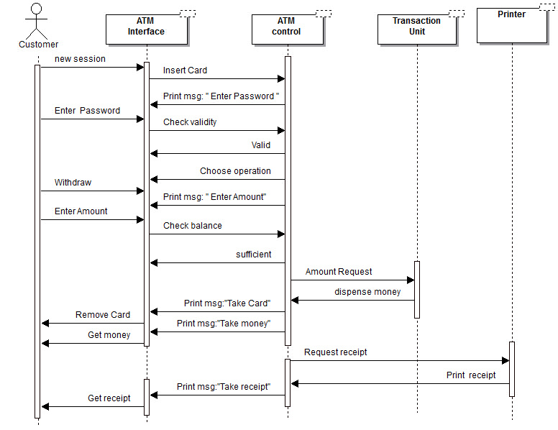
EXAMPLE

Slide 18
TASKS
Design a class diagram for a software system of your choice. Identify at least three classes. Also transform your class diagram into code in any object-oriented programming language. Show their interactions in a main class.
Design the Sequence diagram for Courseware Management System case study application. The following use cases for the Courseware Management System were defined:
· View courses
· Manage topics for a course
· Manage course information
· View course calendar
· View tutors
· Manage tutor information
· Assign courses to tutors
DEADLINE: Note: The diagrams should be clear and well designed.

